Slide 1
AI Wars

Slide 2
Who Are the Key Players?
What are their strengths and weaknesses here?

Slide 3
Google’s Hesitation?
Why did Google hesitate to launch a commercial LLM product?

Slide 4

AI Value Chain
Where do costs come from in developing AI Products?
What are the primary ways to monetize ‘AI Products’?

Slide 5
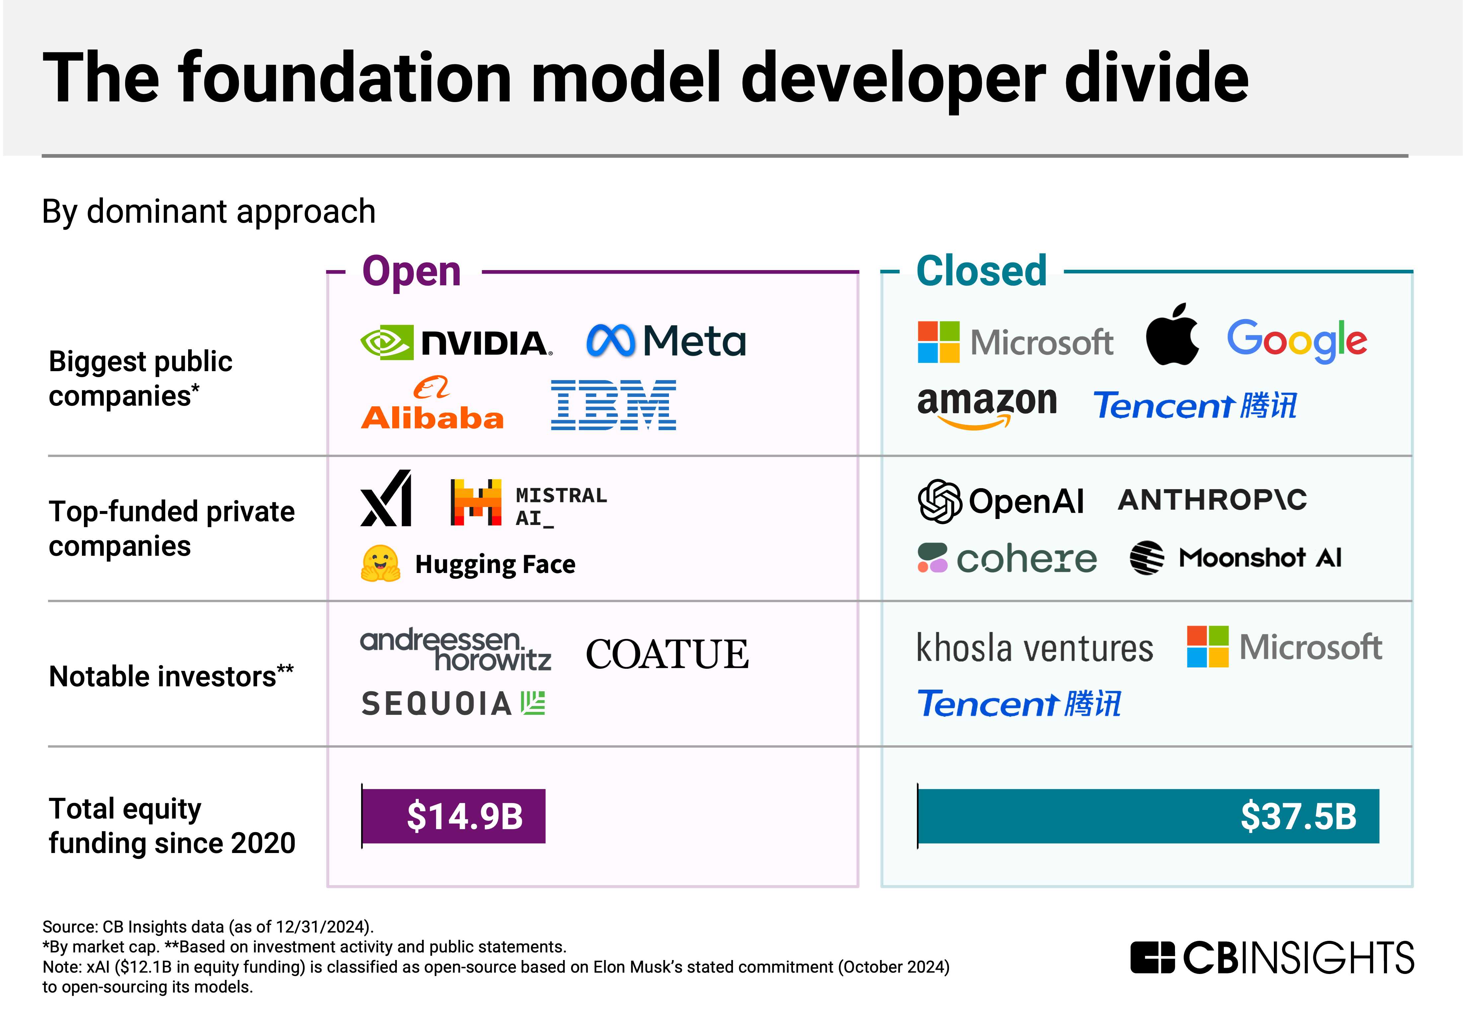
Closed vs. Open Source
Why do companies pursue closed- source (vs. open-source) strategies with large foundation models?

Slide 6
Quantization & Distillation
What is the value of these techniques?

